Slide 1
New Generation
CoffeeMaker

Slide 2
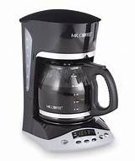
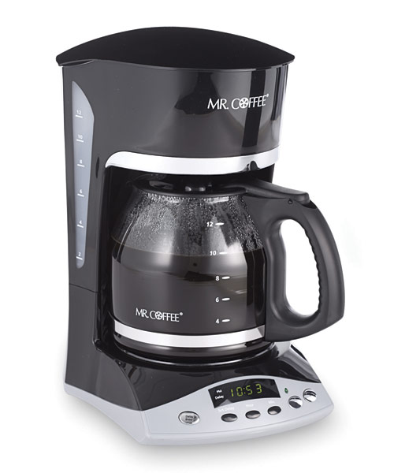
what does coffeemaker mean to you ?
LIFE
EDICTION
MORNING
RITUAL with cigarette
ENERGY BOOST

Slide 3
How to modify it?
money change
coffee network
more coffee
pay-card system
block-chain
filters
stronger!
faster!

Slide 4
What about time Time-saving ?
TIME
It often happens that you do not have time to make yourself a coffee

Slide 5
How ?
. Install our app
. Choose the coffee you like
. Regist coffee-assignment
And that’s all !
NOW when you will be nearby, the coffee-maker will do your order

Slide 6
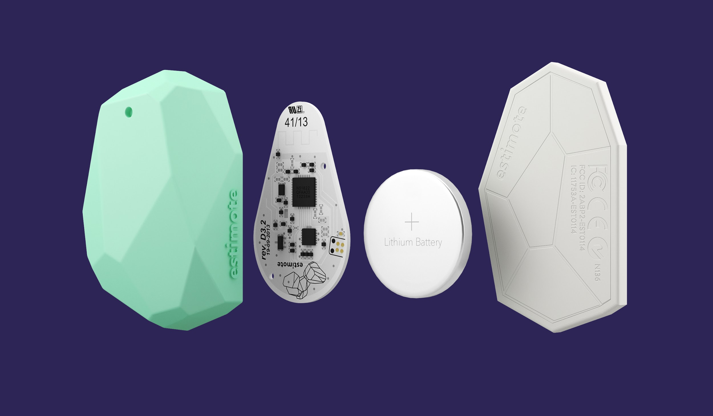
Beacons
GPS beacon tracker
Monitor commercial drivers
Easy to use, easy to setup
Track young drivers
Completely portable , place it anywhere
Connects to Google Earth or Google Maps

Slide 7
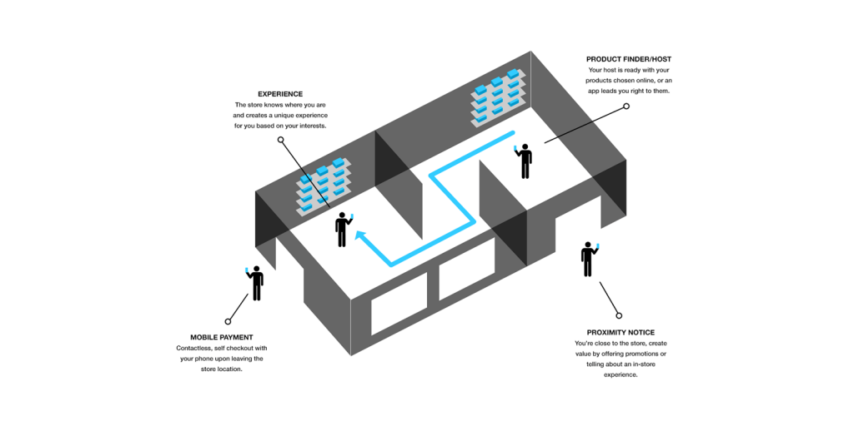

Slide 8
New Generation
CoffeeMaker
Save your time !
Choose

